Slide 1

Search Graphs
Problem Space Representation

Slide 2
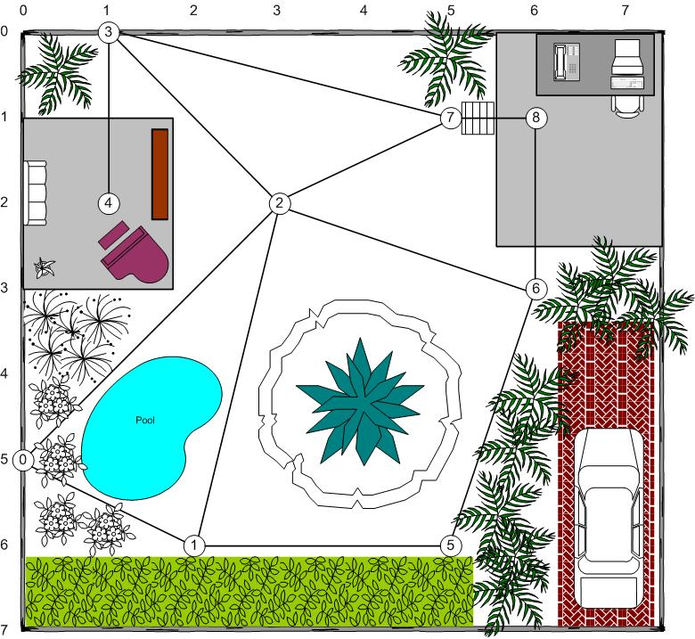
Search Graphs
For tile-based path planners, the terrain and the search topology (the search space) are the same. However, we can also use a separate graph for the search space based on geometric terrain (2D or 3D).
Waypoint Graphs
Vertices are points in space (waypoints)
Edges are line segments with length
Returns line-based path, point-to-point
Waypoint graphs can suffer from suboptimal and/or unnatural looking paths due to poor placement, etc.
Navigation Meshes
Vertices are polygons
Edges are portals between polygons
Returns a polygon channel
Navigation meshes usually require additional techniques to develop a path from the channel ( such as funneling.)

Slide 3
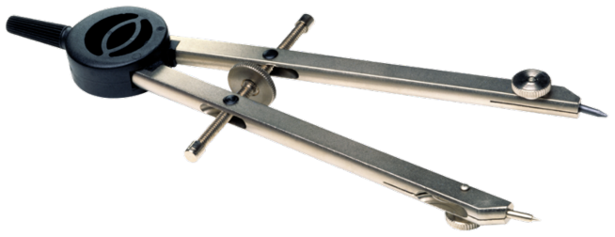
Automatic Graph Generation
Graphs can be automatically generated and updated.
Nav-meshes can be automatically generated/deformed.
Unfortunately, most deforming solutions are trade secrets.

Slide 4
Path Refinement
When our path is an abstraction of the traversable space, we can further enhance that path refine its trajectory and aesthetics, making it more “natural”.
Path Refinement Techniques
String-Pulling
Funneling
Path Smoothing
Steering Behaviors (later!)

Slide 5
String-Pulling
The String-Pulling algorithm identifies intermediary steps that can be removed from a path to improve it.
def string_pull(old_path):
path = list(old_path)
start_index = 0
while len(path) > i + 1:
if walkable(path[i], path[i+2]):
del path[i+1]
else:
index = index + 1

Slide 6
Funneling
The funnel algorithm plots an optimized path when the vertices in a graph are polygons (such as tiles or triangles).
def funnel_path(start, goal, channel):
apex = start
path = [start]
portals = getPortals(channel) + [(end, end)]
right, left = portals.pop(0)
for portal in portals:
if apex == right or clockwise(apex, portal[0], right):
if clockwise(apex, left, portal[0]:
right = portal[0]
else:
apex = left
path.append(apex)
right, left = portal
if apex == left or clockwise(apex, left, portal[1]):
if clockwise(apex, portal[1], right):
left = portal[1]
else:
apex = right
path.append(apex)
right, left = portal
path.append(goal)
return path
left
right
portal[1]
portal[0]
Don’t forget the agent has width!
# clockwise() returns “False” if any points same

Slide 7
Path Smoothing
Even after refining, the resulting path often has unrealistic hard edges / turns. We can use path smoothing techniques to achieve a result that is less jarring.
Approaches
Splines (rare)
Turn radius integration
Directional A*

Slide 8
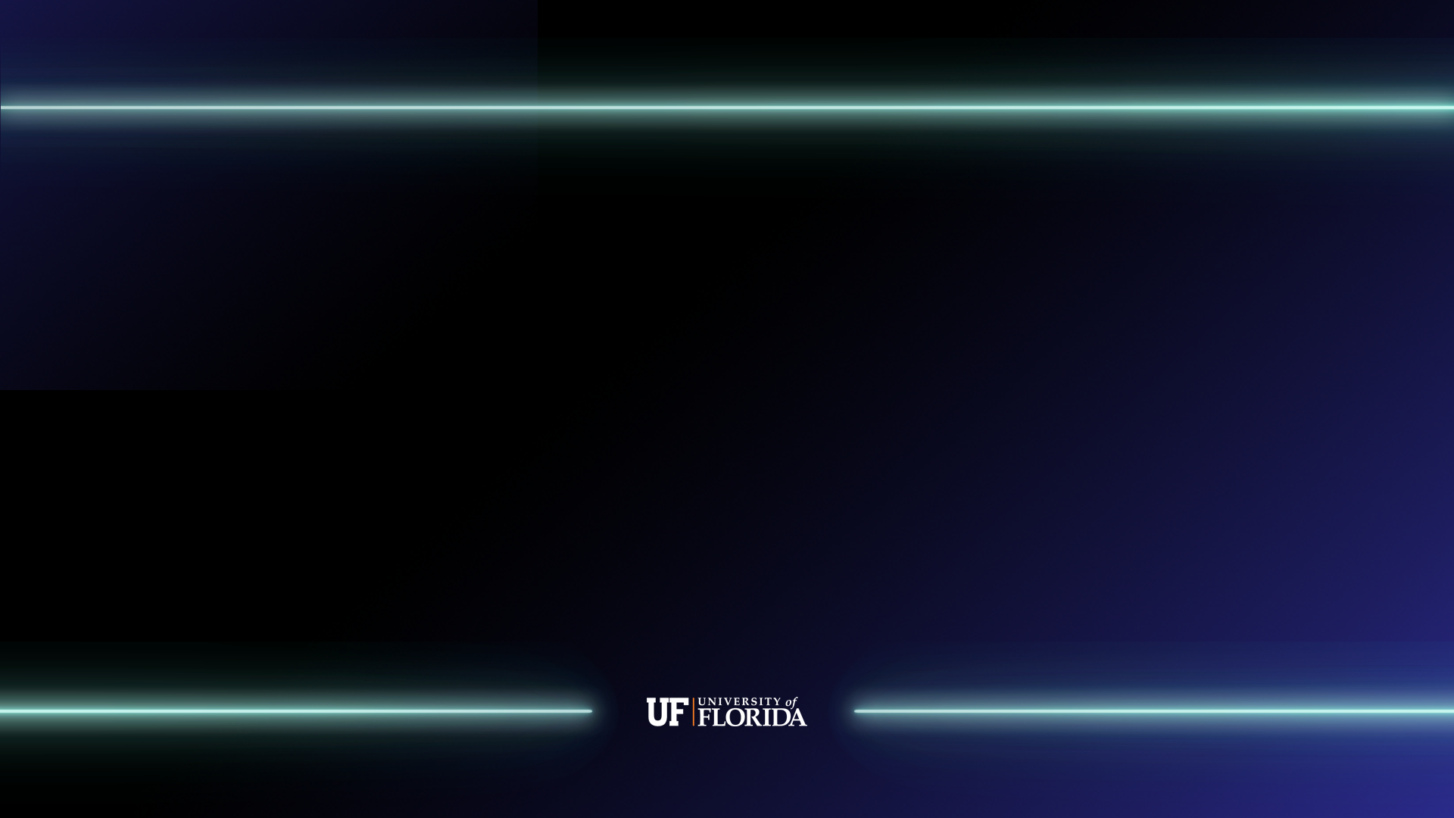
References
Infinite_Loop84. 2009. String Pulling Explained. Gamedev.net Forums. https://www.gamedev.net/forums/topic/539575-string-pulling-explained/
Ash Hamnett. 2012. Funnel Algorithm. Ash Hamnett: Junior Games Programmer. http://ahamnett.blogspot.com/2012/10/funnel-algorithm.html
Dan Sunday. 2012. Area of Triangles and Polygons. Geometry Algorithms. http://geomalgorithms.com/a01-_area.html
Marco Pinter. 2001. Toward More Realistic Pathfinding. Gamasutra. https://www.gamasutra.com/view/feature/131505/toward_more_realistic_pathfinding.php

